Slide 1
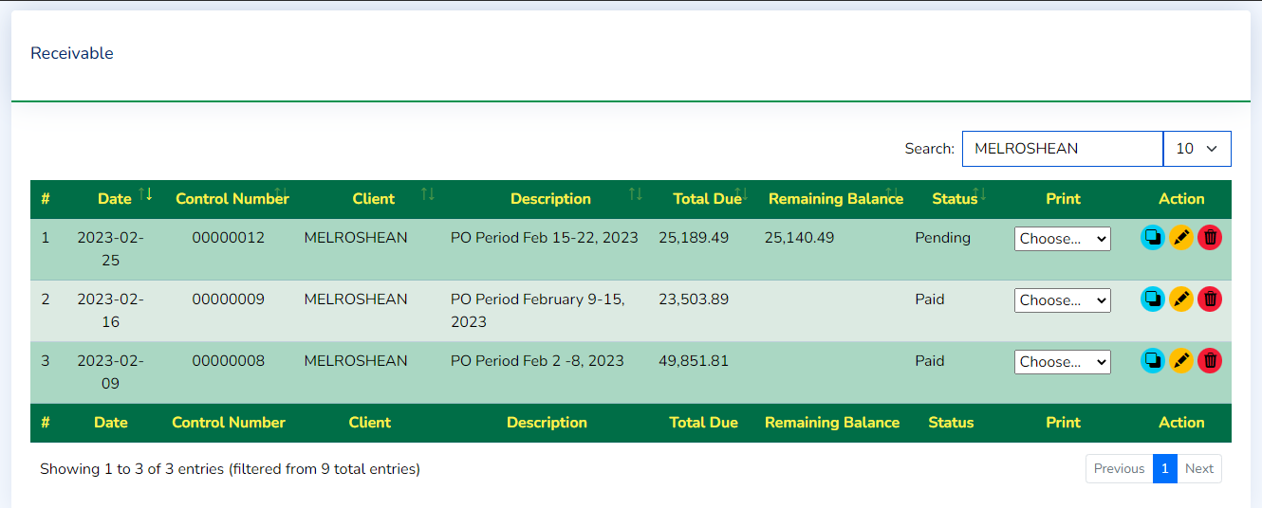
Add Payment
Remaining Balance

Slide 2

Select Item to Print
SOA – Statement of Account
Billing
Receivable

